Slide 1
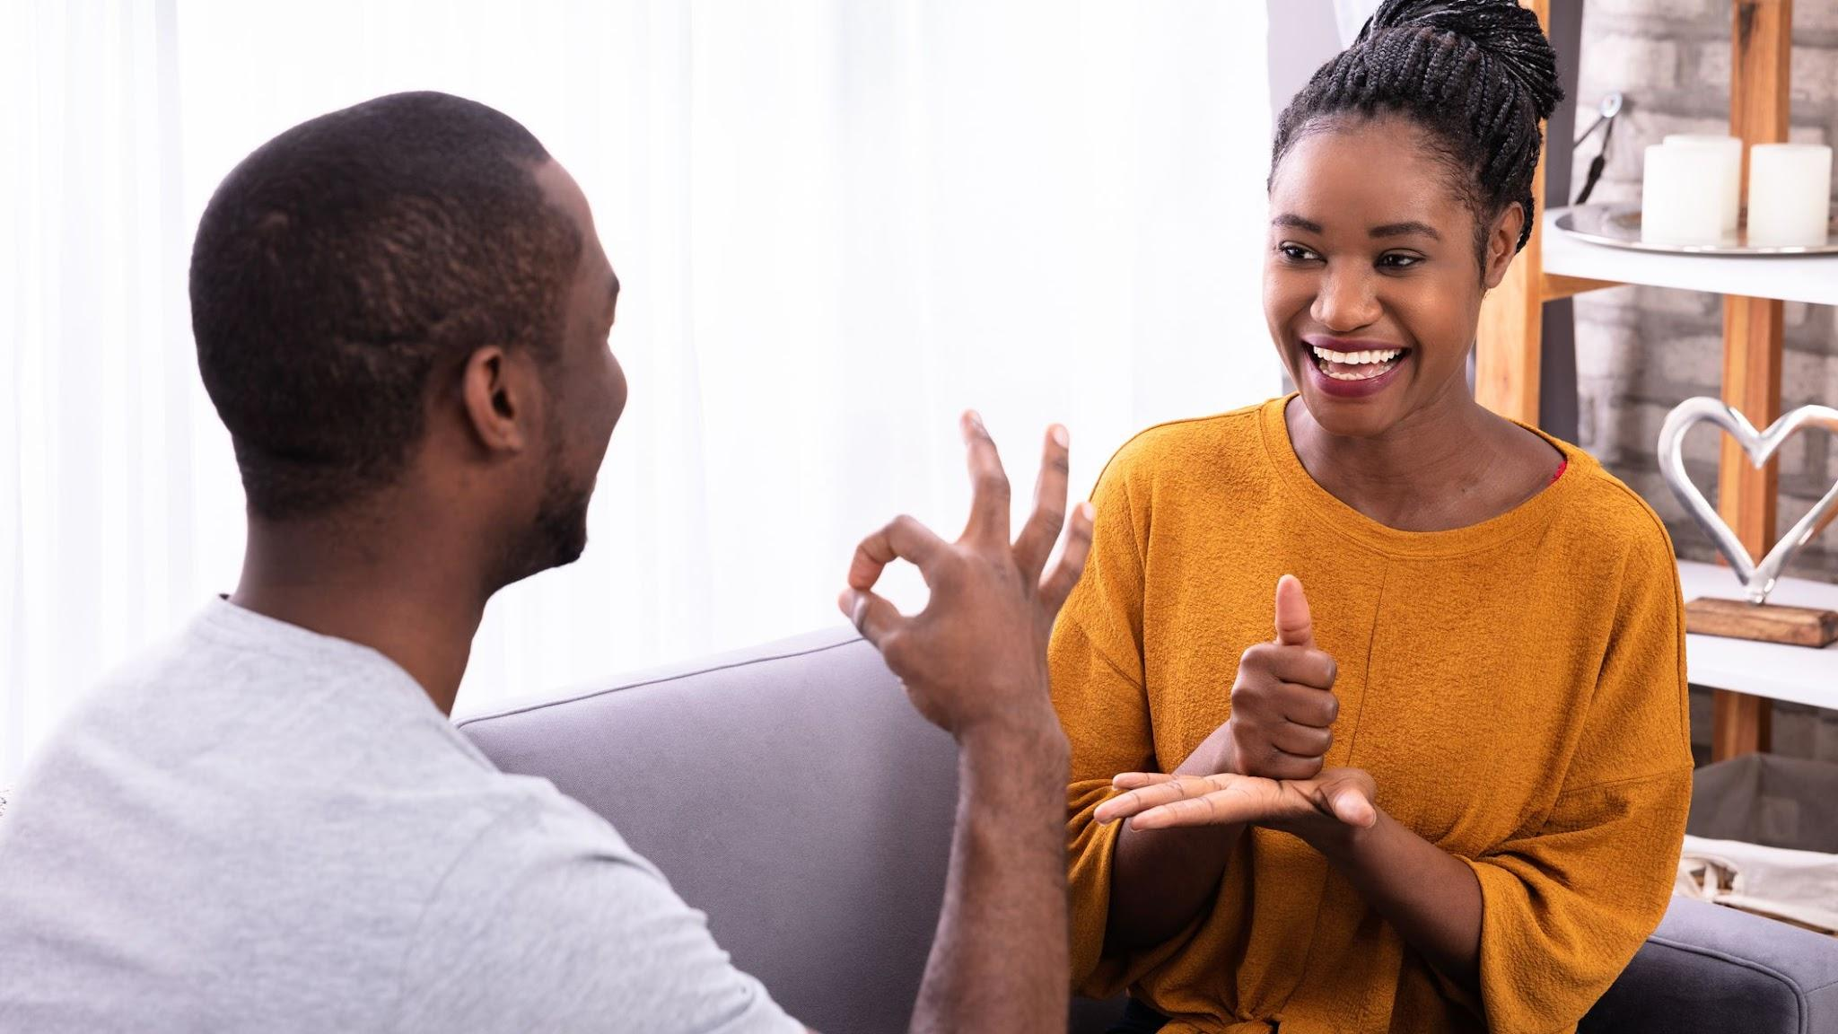
American Sign Language Alphabet Image Classification
Team 5 | Status Report
Beard, Bennion, Carlson, Napolitano

Slide 2
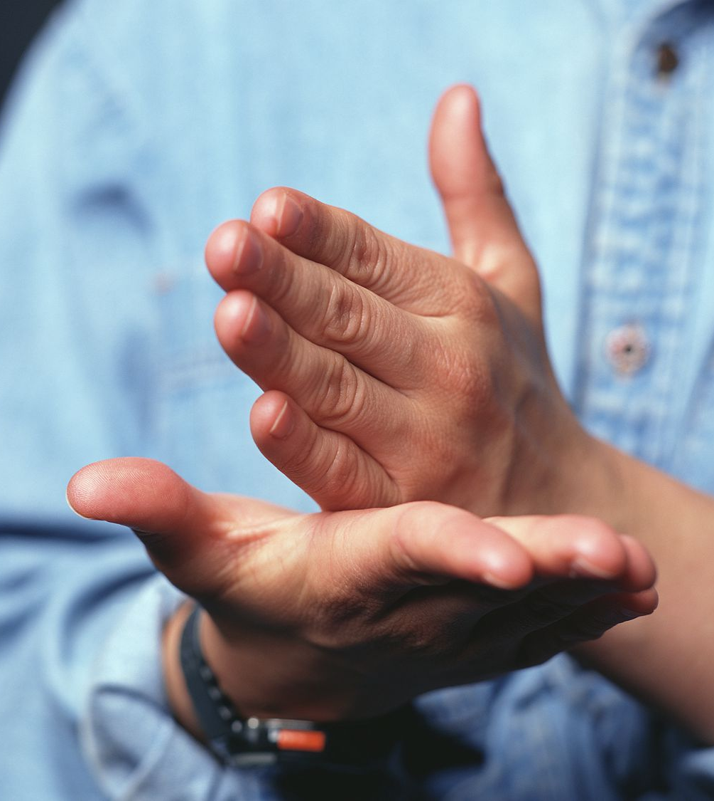
The Project
Using Computer Vision
To Serve Those Hard of Hearing

Slide 3
Goals
1 | Compile an Accurate ASL Alphabet Data Set | Complete
1.1 | Record Raw Video Footage of ASL Alphabet Signs | Complete
2 | Preprocess Data Set To Prepare for Modelling | Complete
2.1 | Split Video Into Still Frames | Complete
2.2 | Normalize Color | Complete
2.3 | Normalize Size | Complete
2.4 | Normalize Resolution | Complete
2.5 | Produce Image Vector CSVs | Complete
3 | Exploratory Data Analysis | Complete
3.1 | Image Class Balance Analysis | Complete
3.2 | Analysis of the Basic Metrics of Variables | Complete
3.3 | Non-Graphical and Graphical Univariate Analysis | Complete
3.4 | Feature Engineering and Analysis | Complete
4 | Develop an ML model capable of learning ASL alphabet | In Progress
4.1 | Research Modeling Techniques | In Progress

Slide 4
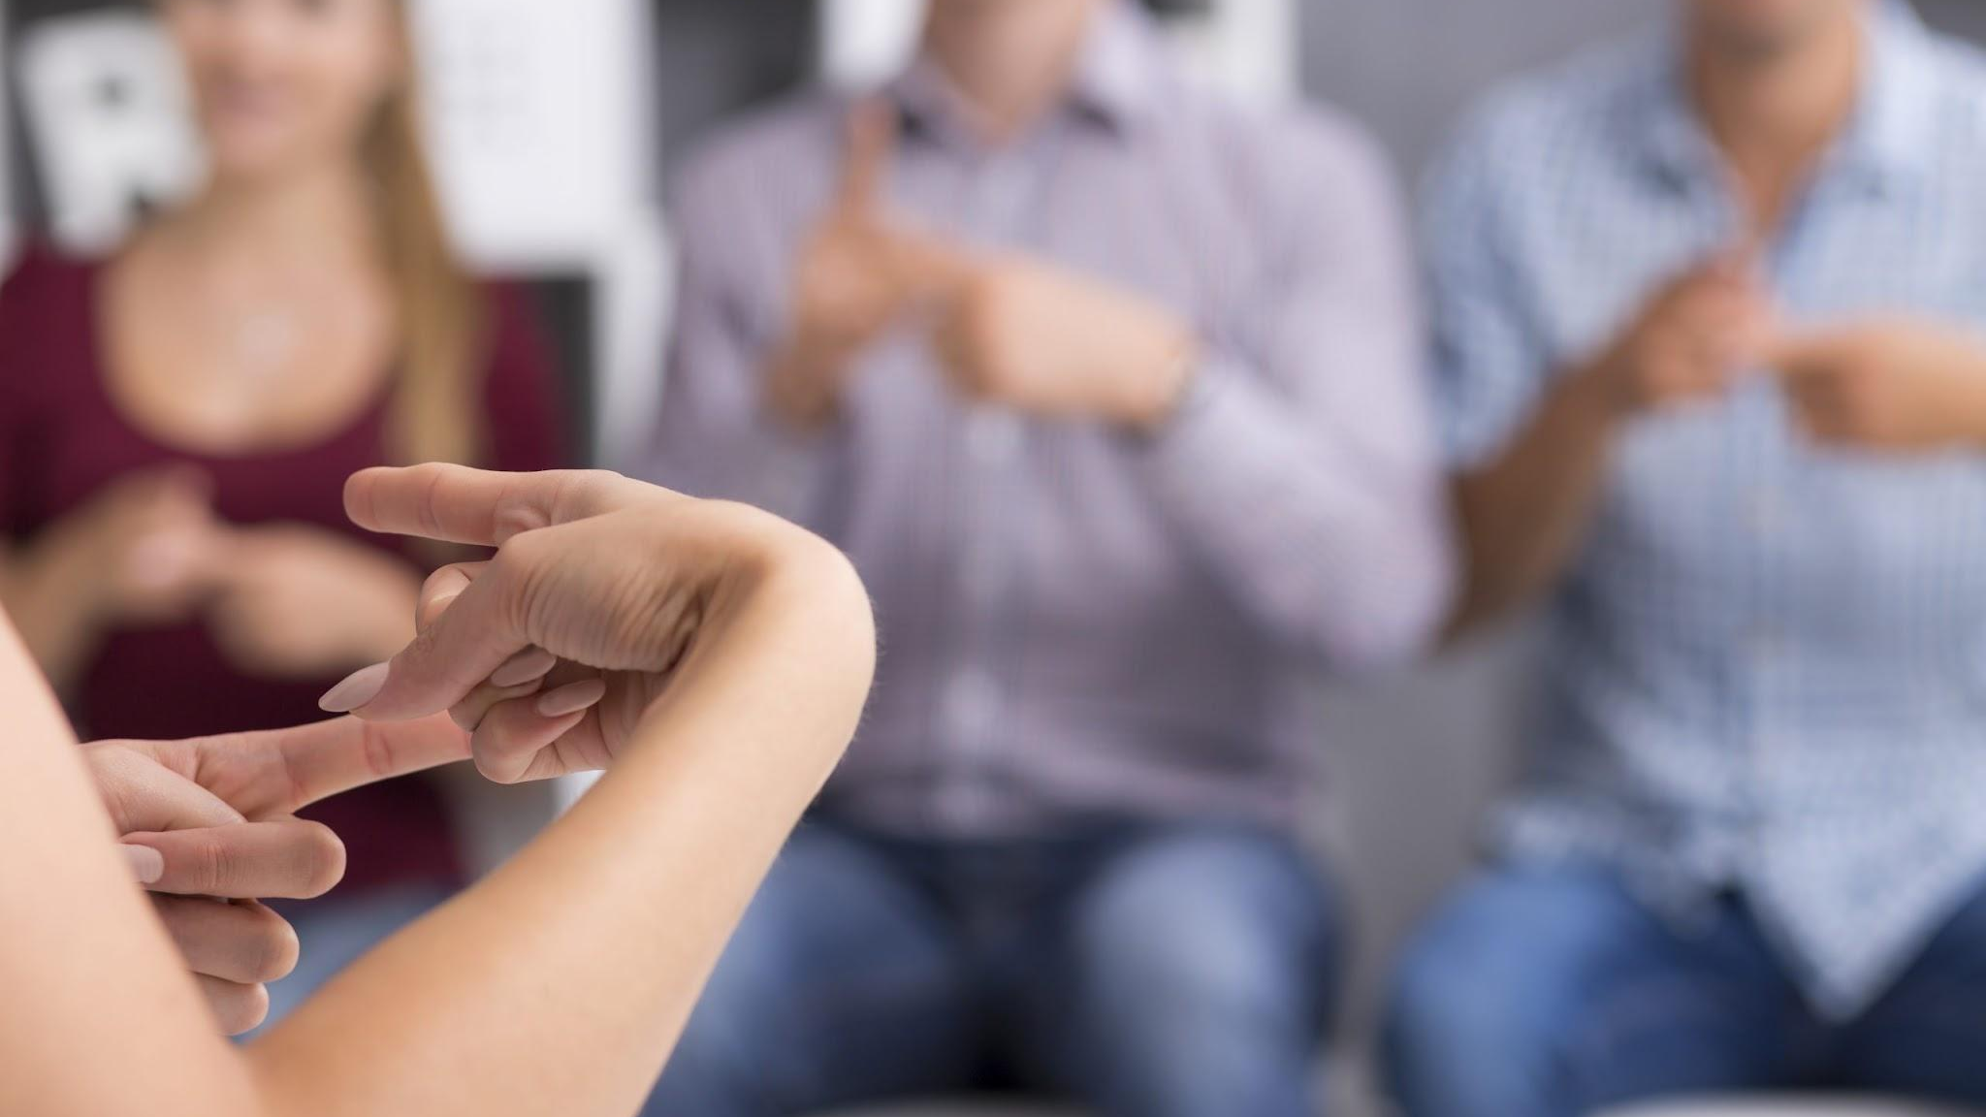
EDA Summary
Notes:
zach

Slide 5
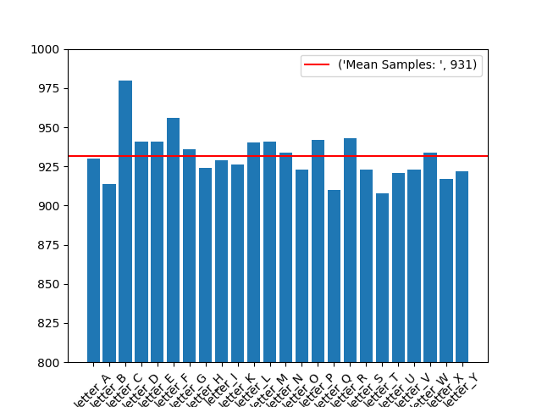
Image Class Balance Analysis
All 24 classes are well balanced
Mean samples across classes is 931 images
Letter C class contains 5% more samples than the mean

Slide 6
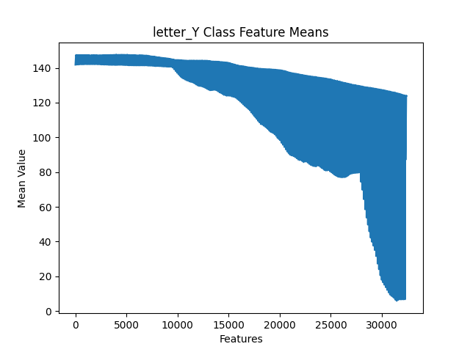
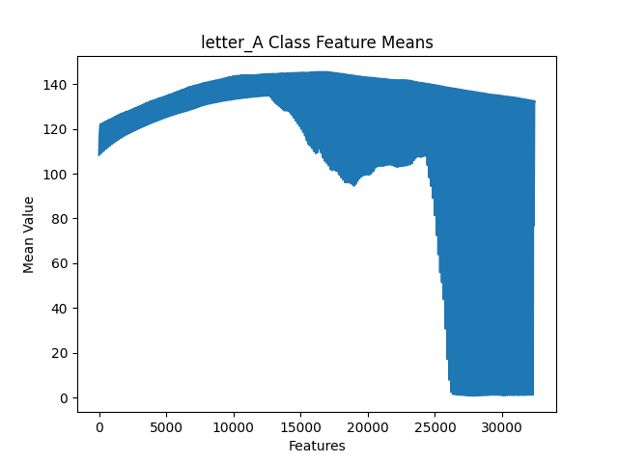
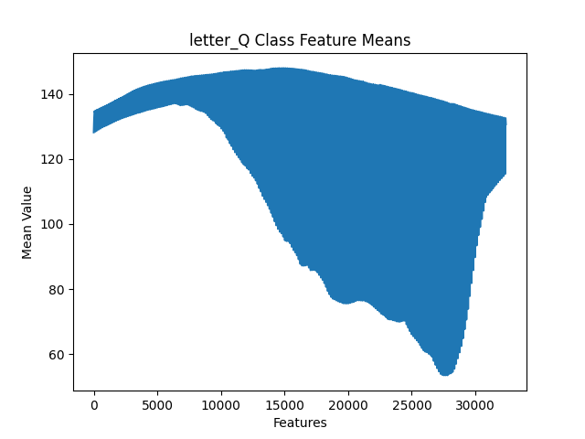
Analysis of the Basic Metrics of Variables
Dataset consists of images and therefore the feature space is composed of pixels
Each feature is a value between 0 and 255 representing numerical/continuous grayscale hues from black to white
Plots are generated for each class to show the density of the 32,400 possible features
The examples to the right show that classes are clearly distinguishable by simply observing their feature density profiles

Slide 7
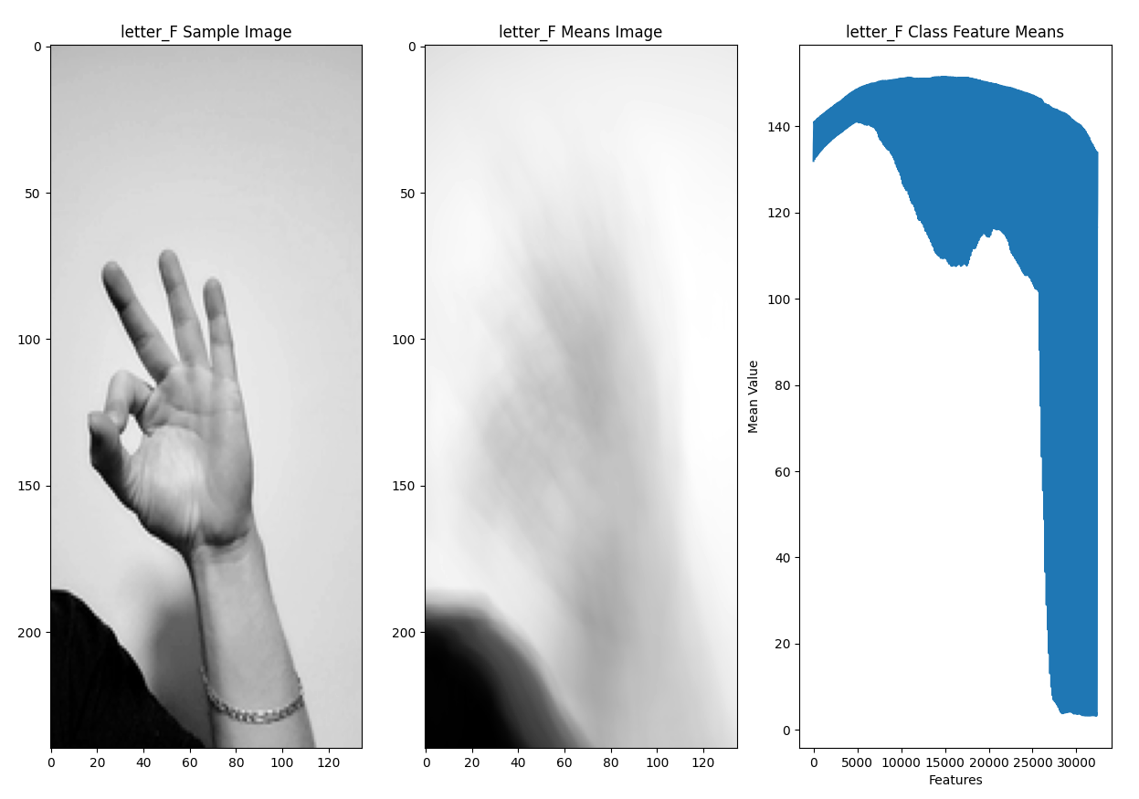
Non-Graphical and Graphical Univariate Analysis
The mean feature values for each class are produced (middle image) and compared against the first image from the class (left) and the feature means plot (right)
Visual comparison of classes to get a general sense of where classes overlap in similarity, and a general sense of deviation
Notes:
zach

Slide 8
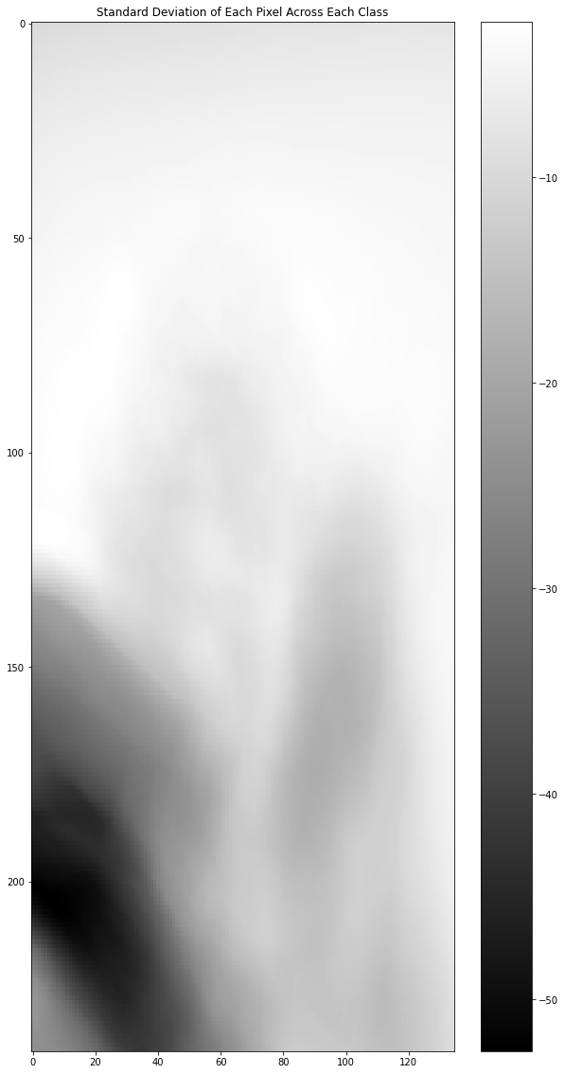
Feature Engineering and Analysis
Standard deviation was computed across classes for each feature to highlight least-informative features
The goal of identifying the least-important features is to minimize the featurespace down to the most useful features
Assist with accuracy
Avoid overfitting as it reduces noise within the dataset
The grayscale image was inverted so that the darker regions represented areas with higher standard deviation and vice-versa.
The top portion of the image is light, meaning it is consistent across all classes and does not provide much value for training. The team opted to subset the DataFrame to exclude these pixel values.
Notes:
zach

Slide 9
“Re” Processing

Slide 10
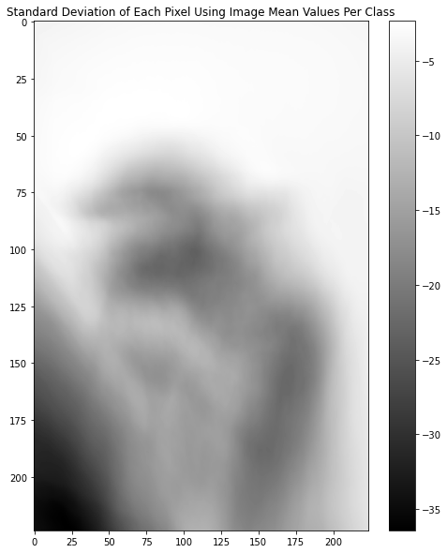
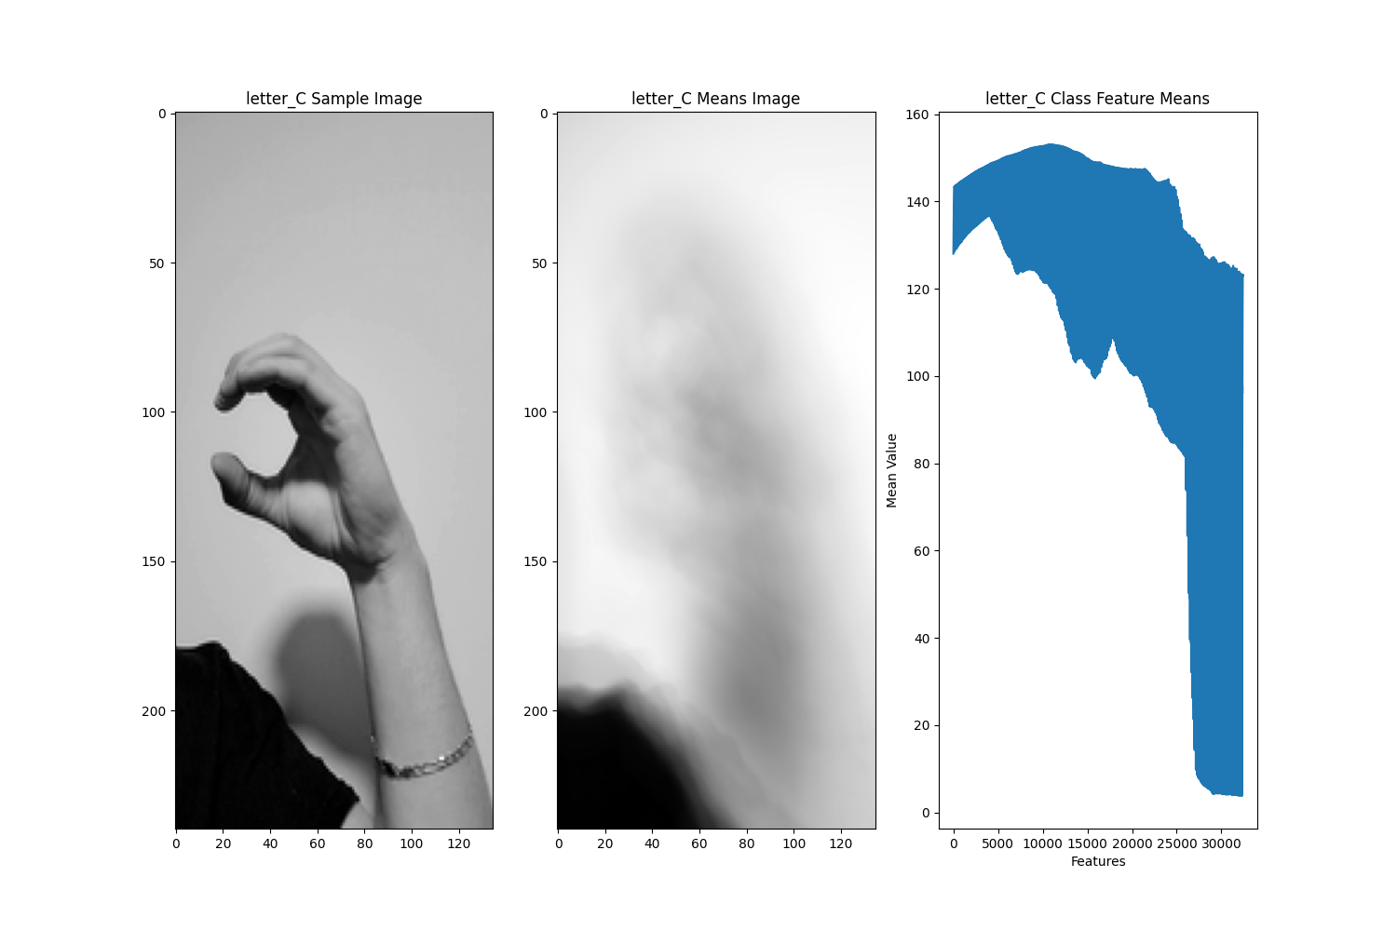
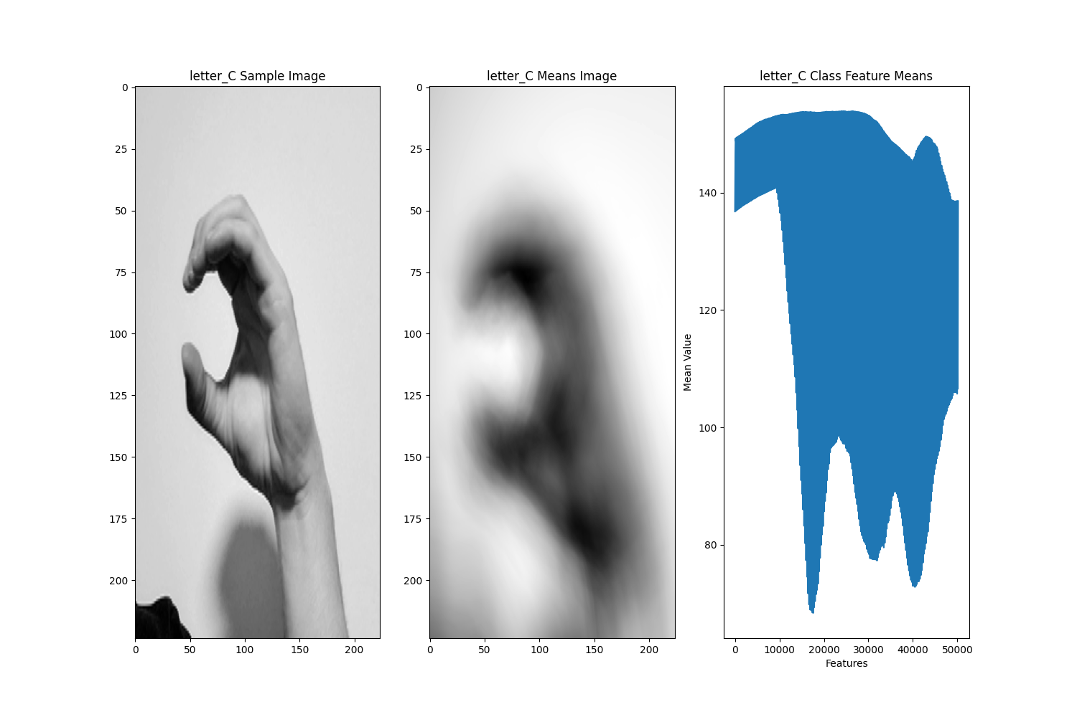
ReProcessing Approach
Before
After
Revisited our preprocessing approach to minimize the
amount of unnecessary pixels in our training images.
Improvements:
Shrink original 1080p images to 224x398
Add y axis centering
Crop images to 224x224
Reapply grayscaling
Result:
Images with more focus on operative
subject (hand) and greatly reduced
proportion of unnecessary pixels

Slide 11
Training Research and Pre-Training
Due to the nature of our dataset, EDA is somewhat limited
We have already begun to consider our training and pre-training process.
Pre-Train
Minimal imbalance in classes
May benefit from over-sampling
Notes:
zach

Slide 12
Training Research and Pre-Training
Convolutional Neural Network (CNN)
Prior work achieved 98% accuracy for ASL alphabet... with at least one invalid class sample set
Prior work consisted of 7 layers: 3 CNN, 5 ReLU, 1 Softmax
Transfer Learning
VGG16 - Visual Geometry Group from Oxford
16-layer deep pre-trained CNN
Prior work achieved 97% accuracy for ASL alphabet... with at least one invalid class sample set
Notes:
zach

